Slide 1
ML Retail Project
Optimizing retail marketing strategies through behavior analysis and financial forecasting.
Presented by:
Layth Khemakhem

Slide 2
Agenda
Introduction | Marketing Revenue Forecasting
Workflow Pipeline | Web Application
Data Pretreatment | Challenges Faced
Churn Model | Areas of Improvement
Behaviour Classifier | Conclusion
2

Slide 3
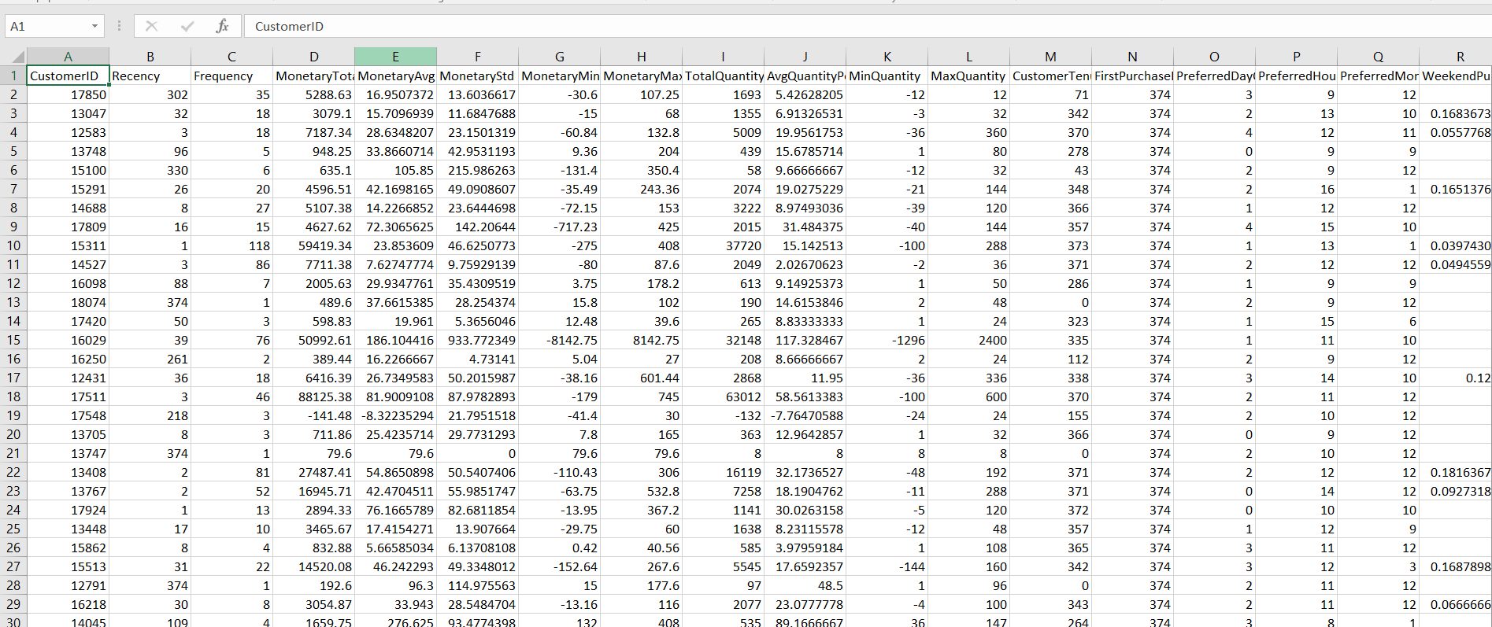
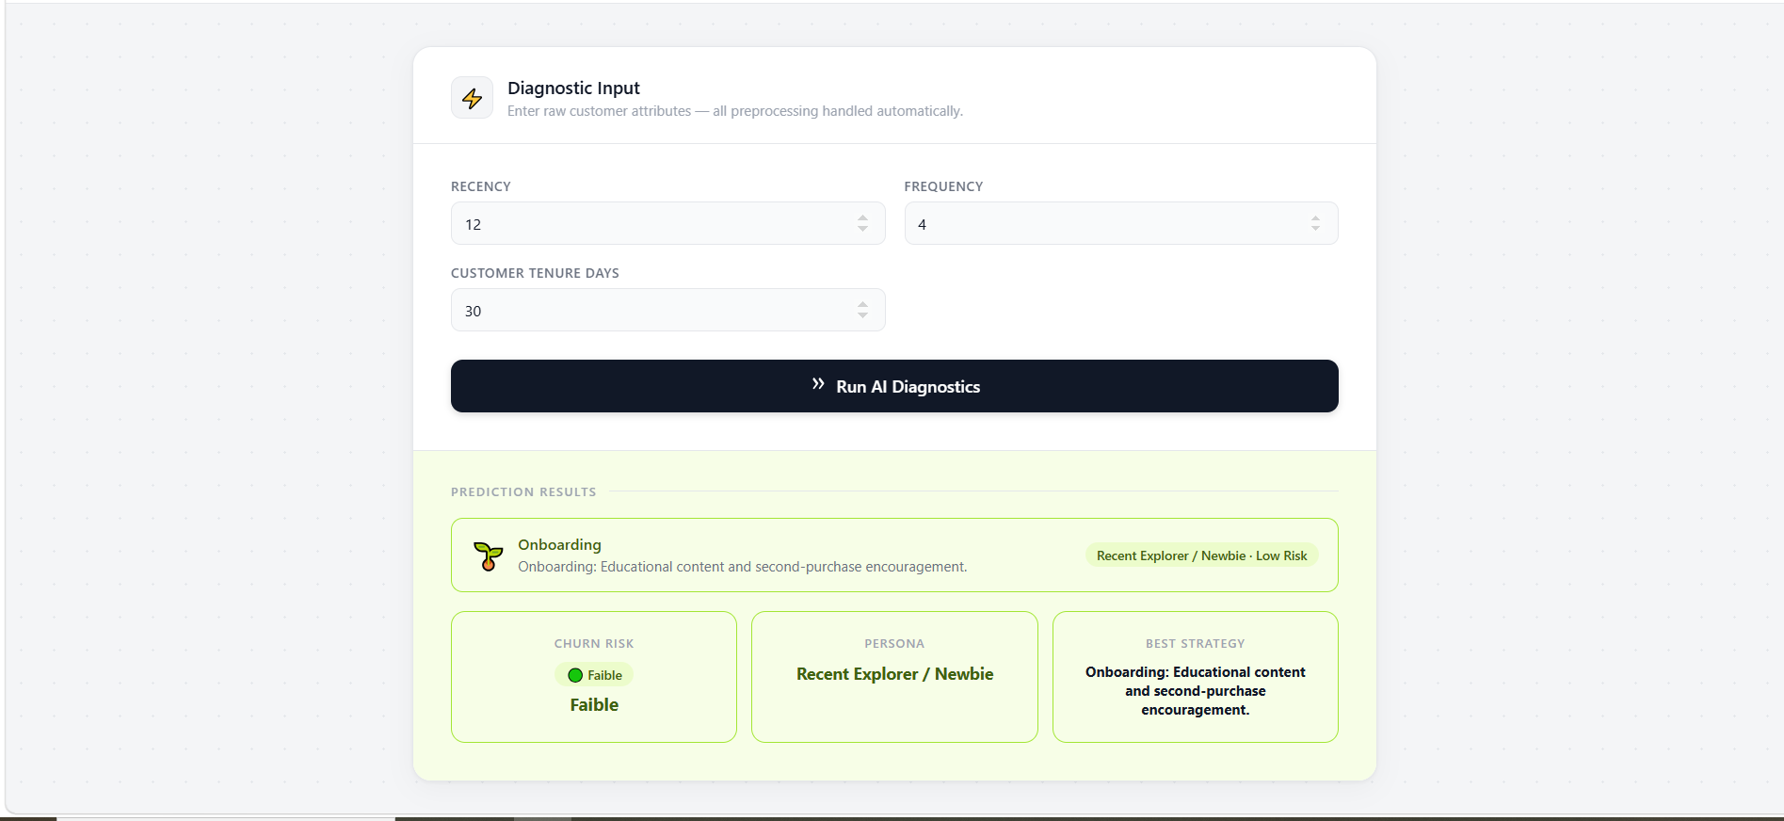
Introduction
Project Goals
End-to-end machine learning pipeline
Goal: optimize marketing decisions
Combines:
Customer churn prediction
Customer segmentation
Revenue forecasting
Delivered via interactive web dashboard
3

Slide 4
Workflow Pipeline
Raw Data
Data Cleaning
Data Filling
Application
Model Testing & Training
Dataset Making
4

Slide 5
Data Pretreatment
Data Cleaning
Data Filling
Removing Missing Data (with Median) | Mapping Categories
Removing Invalid Data | Normalising Cyclical
Normalising Dates | Skewing
Handling IP (Full Parse | Handling IP (Full Parse
Removing Duplicates Rows
Removing Features with High Correlation
Removing Anomalies (IsolationForest)
Removing Low Variance Features
5

Slide 6
Churn Model
XGBoost Classifier | XGBoost Classifier | XGBoost Classifier
Input | Output | Results
Recency Frequency Tenure | 4 levels of Churn Risk | Accuracy 44% (bad at predicting high risk)
6

Slide 7
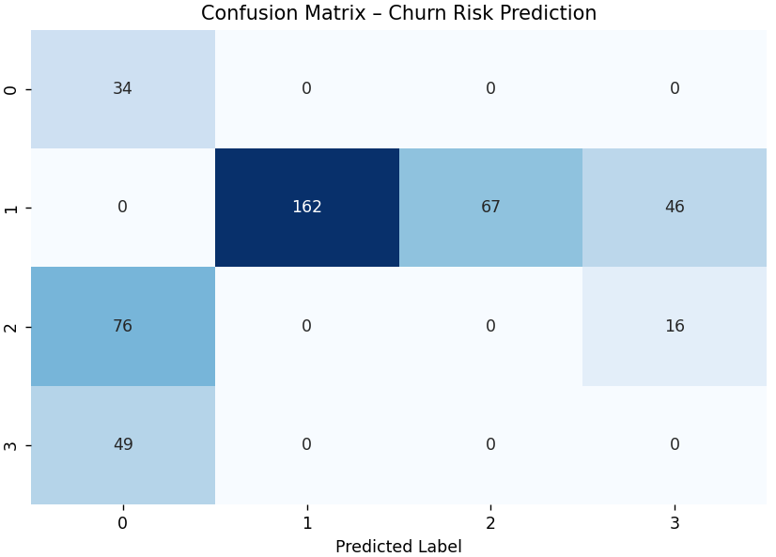
Churn Model
Confusion Matrix
7

Slide 8
Behaviour Classifier
K-Means (K=4) | K-Means (K=4)
Input | Output
Recency Frequency Tenure | 4 levels of Behviours: Loyal Active (37.2%) Recent Explorers (27.7%) At-Risk (18.3%) High Spenders (16.8%)
8

Slide 9
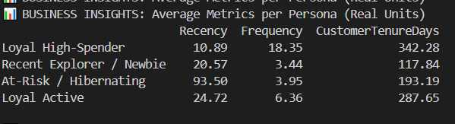
Behaviour Classifier
Clusters Values
9

Slide 10
Income Predictor
Random Forest Regressor | Random Forest Regressor | Random Forest Regressor
Goal | Input | Insight
Predict seasonal spending | Customer behavior Persona Region Season | Most income from UJ Other regions (besides Centrale Europe) have negligeable income individually
10

Slide 11
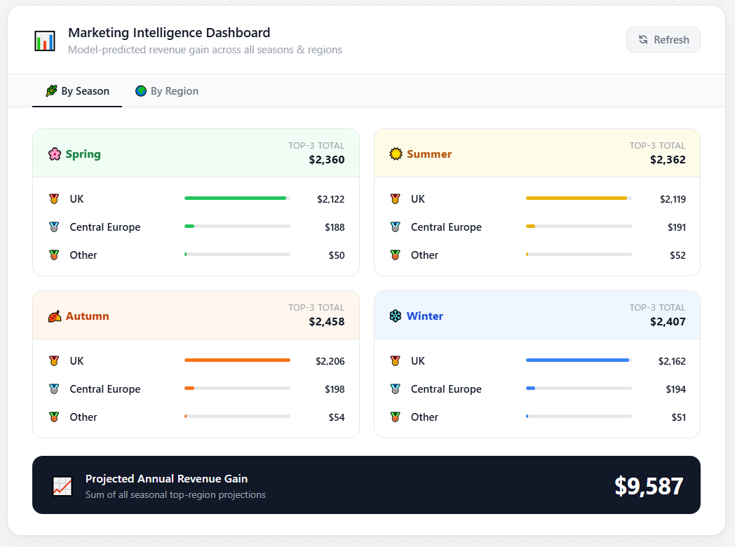
Web Application
Custmer Interface
Income Interface
11

Slide 12
Challenges Faced
Erronic Data
Churn Data Leakage
2 app synchronasation
Tenure>Recency
Negative Monatary
12

Slide 13
Area of Improvement
Fix data leakage
Handle imbalance
Add new features
Improve regional grouping
Add time-series modeling
13

Slide 14
Conclusion
The ML Retail Project successfully developed an end-to-end machine learning pipeline to optimize marketing decisions through an interactive web application. By combining an XGBoost churn prediction model, a K-Means behavior classifier that segments users into four distinct customer personas, and a Random Forest Regressor for revenue forecasting, the project effectively translates complex data into actionable business insights. However, the development process revealed significant challenges—such as churn data leakage, negative monetary values, and erronic data where tenure exceeded recency—which hindered initial model performance. Moving forward, the project aims to address these limitations by fixing data leakage, handling class imbalances, and introducing time-series modeling to further enhance the reliability of its regional groupings and overall financial forecasts.
14

Slide 15
Thank You for Your Attention

